Slide 1

Why DITA?
Lisa Fleischmann
May 2020

Slide 2
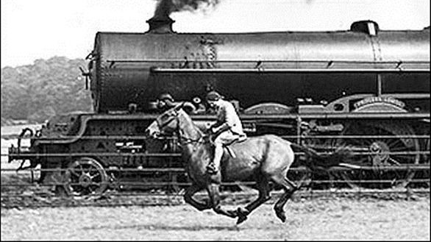
Don’t get left behind!
Notes:
This is a photo taken during the Industrial Revolution.
It reminds me how we need to keep up with technology.
(Click)
We don’t want to get left behind.
I remember many years ago, working on two massive Microsoft Word documents for two audiences: partners and employees.
The documents were over 200 pages in six formats, posted in six places, chunked into small files in some places and in one large Word file and PDF in other places.
When you go over a hundred pages in Word, you encounter problems.
When I was in the final revisions stage, I ended up working three days without sleep.
I thought there must be a better way.
Source of image:
https://i.pinimg.com/originals/07/ca/a1/07caa106ebbbc7aaadfa20039aa99bb2.jpg

Slide 3

Introduction
Why did I choose DITA?
Why is DITA better?
DITA FAQs
Notes:
(Click)
I will cover three things:
1. Why did I choose DITA?
2. Why is DITA better?
3. DITA FAQs

Slide 4
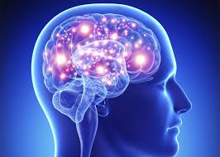

Why did I choose DITA?
My brain is wired for tagging
Notes:
(3 clicks)
Why did I choose DITA?
My brain is wired for tagging.
And breaking content into chunks.
And reusing content.
Source of image: How Much Can Your Brain Actually Process? Don’t Ask.
https://slate.com/technology/2016/03/how-big-is-the-brain-who-knows-even-our-best-efforts-to-calculate-its-capacity-are-flawed-and-meaningless.html

Slide 5
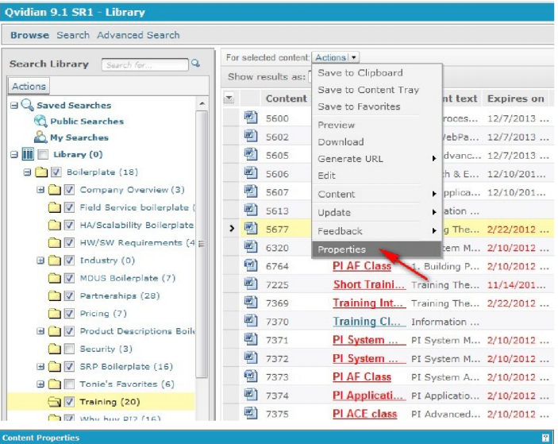

Qvidian Proposal Automation
Library in QPA
Notes:
What is this? (Click)
Qvidian Proposal Automation.
Here is the library (Click)
I worked with this tool for many years.
What do you do with it?
You create content.
You break content into chunks.
You tag it.
You reuse content.
Source of screenshot: Updating Qvidian Content Sample Procedure:
http://data-doctor.info/wp-content/uploads/2014/06/Updating-Qvidian-Content-Sample-Procedure.pdf

Slide 6
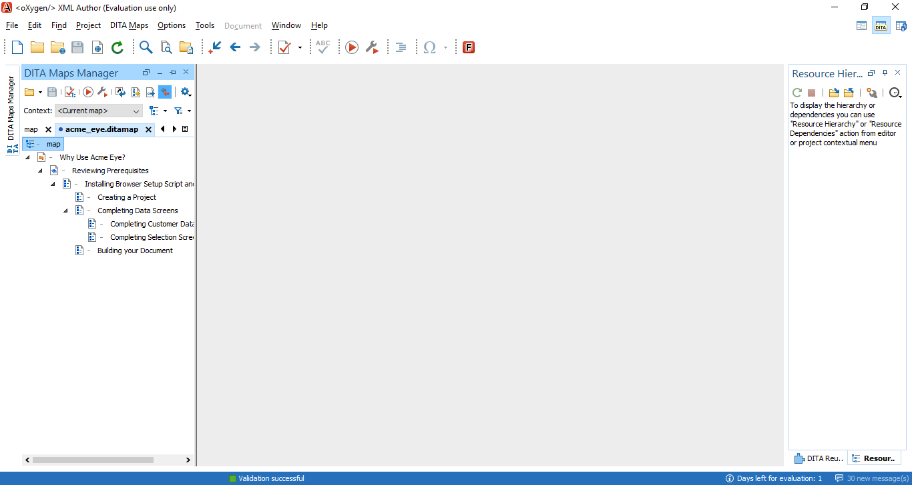

DITA map
DITA map in Oxygen
Notes:
(2 Clicks)
This is a DITA map in Oxygen.
The DITA map gives you structure.
The topic gives you content.
The DITA map stitches the topics together.
This is an example of a DITA map I created based on a user guide I wrote called: Building Proposals with Acme Eye.
What do you do with DITA?
You create content.
You break content into chunks.
You tag it.
You reuse content.
I want to add a note about Oxygen:
Oxygen provides a graphical representation of your DITA map and lets you know if your content is valid or not. For example, if the indicator at the top of the bar is green, your document is valid. Also, you can render the document in Oxygen to see the output.

Slide 7
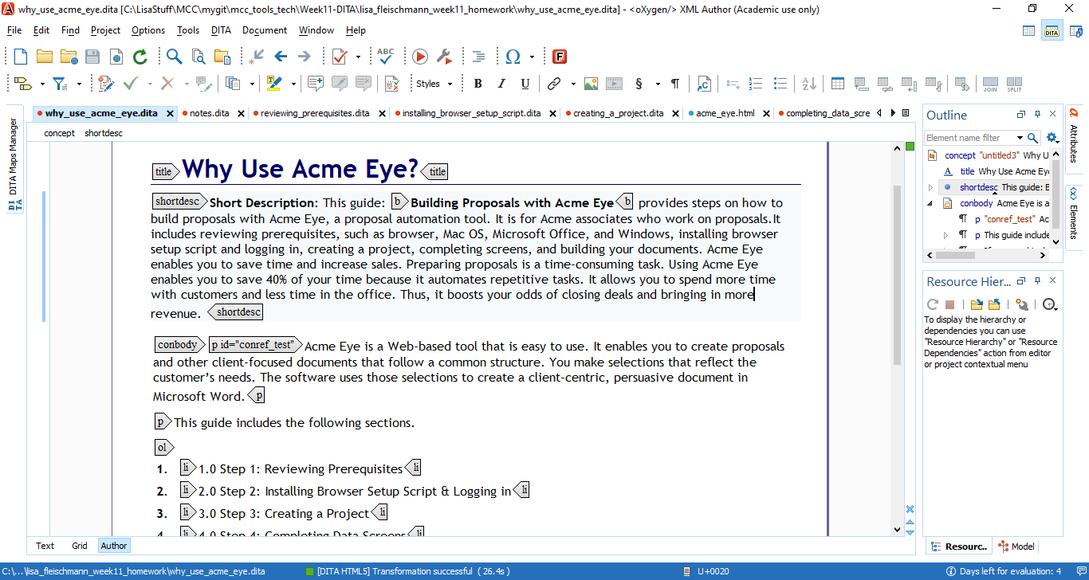
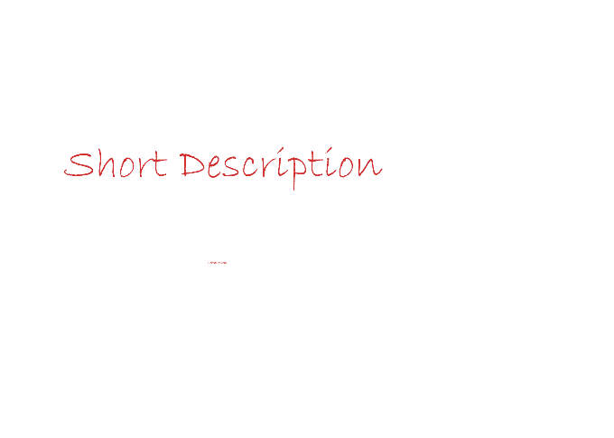
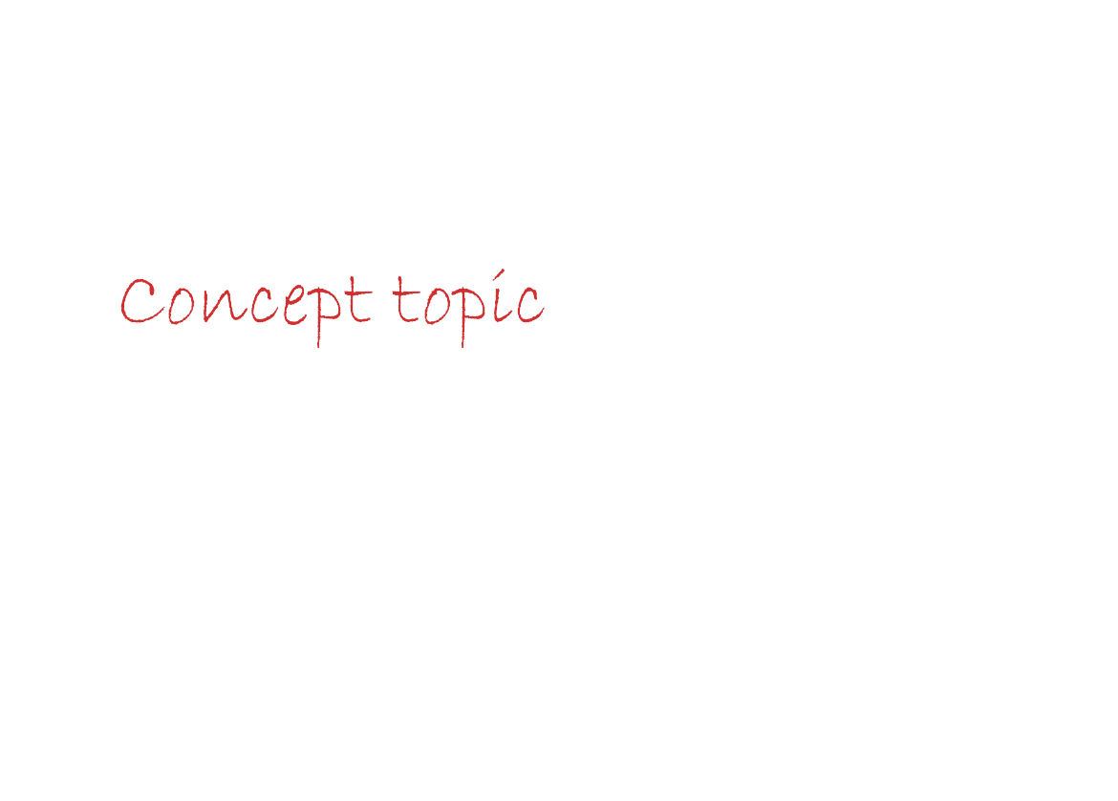
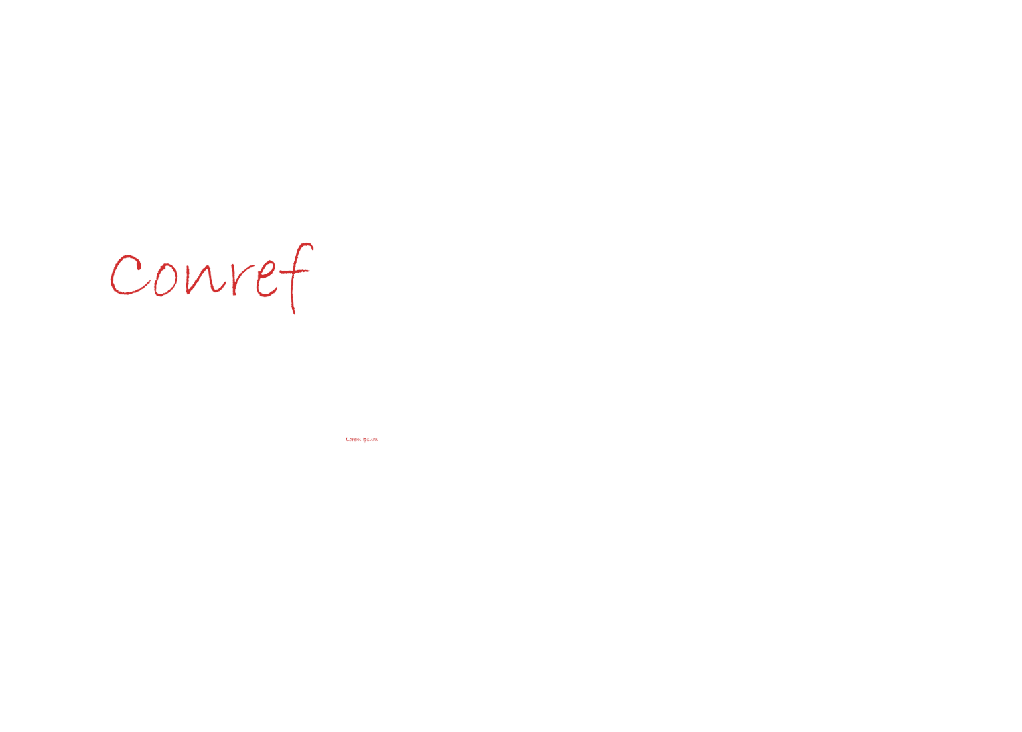

DITA topic
Standard
Structured
Topics: concept, task, reference
Notes:
(click) (DITA topic)
(click) DITA is a standard based, topic-oriented XML modular architecture.
Since DITA is an open standard, you can change or add to your tools with far less cost than other formats.
(click) The structured content in DITA provides:
Consistency
Collaboration
Minimalism
Tagged content in DITA is similar to HTML.
You have similar tagging, such as: p for paragraph and ol for ordered list.
DITA provides content reuse and consistency.
Topics are building blocks to reuse.
Many features enable more reuse.
(3 Clicks) A Content Reference or Conref is an example of reuse.
For example, the second paragraph in this concept topic is a conref.
You always use the same element.
For example, if I want to reuse this conref, it must be a paragraph.
Effective parts of DITA include:
Breaking up your content into concept, tasks, and references.
(3 Clicks) You should include a short description at the beginning of each topic.
You get to sell your topics by writing good short descriptions.
Your short description will show up in search results.

Slide 8
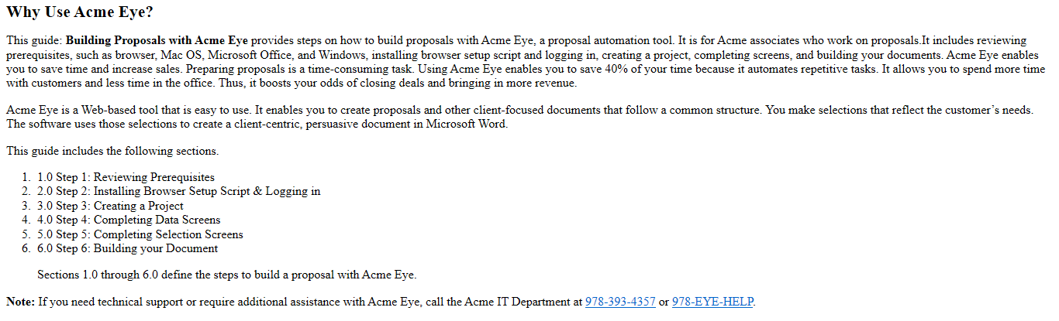

Rendering a DITA topic
Before Rendering
After Rendering
Notes:
(Click) (Rendering a DITA topic)
You can render a DITA topic (or map) in Oxygen to see what the output looks like.
To render a DITA topic (or transform it) in Oxygen:
Select the DITA file you want to transform, click Configure Transformation Scenarios (the “wrench” icon)
Select an Association, for example: HTML5
Click: Apply associated
(Click) You see the output results.

Slide 9
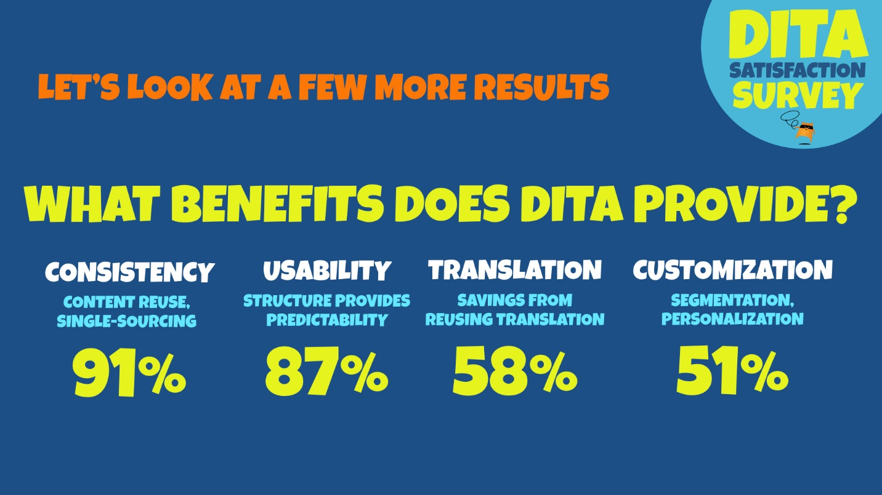

DITA Benefits
Notes:
Now let’s look at results of a DITA Satisfaction Survey by the Content Wrangler in 2017.
When asked: What benefits does DITA provide?
The most common benefits cited were content consistency and content usability.

Slide 10
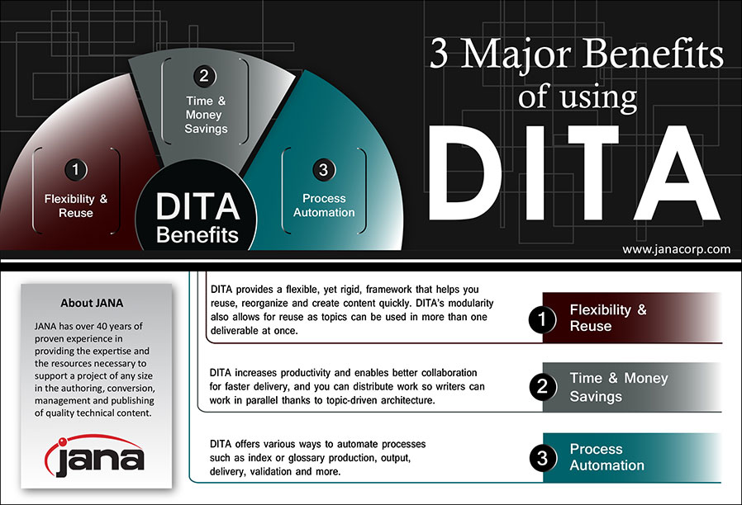

DITA Benefits (continued)
Notes:
(Click) (DITA Benefits continued)
According to JANA corporation, there are three major benefits of using DITA:
1. Flexibility & Reuse
DITA provides a flexible, yet rigid, framework that helps you reuse, reorganize, and create content quickly. DITA’s modularity also allows for reuse as topics can be used in more than one deliverable at once.
I want to add that reuse provides scalability. Because you are reusing and not duplicating content, DITA scales.
2. Time & Money Savings
DITA increases productivity and enables better collaboration for faster delivery, and you can distribute work so writers can work in parallel thanks to topic-driven architecture.
I want to add DITA saves time and money through translation. You only translate what you need to translate.
*For example, if you have a product guide that uses 200 topics (125 pre-existing topics and 75 new topics), if you are using DITA, you send the 75 new topics to translation instead of incurring processing costs on all 200 topics. In this case, the savings is over 60%.
3. Process Automation
DITA offers various ways to automate processes such as index or glossary production, output, delivery, validation, and more.
* Source: Calculating the Financial Impact of DITA for Translation
by Amber Swope
https://www.writingassist.com/resources/articles-3/dita-translation-financials/

Slide 11

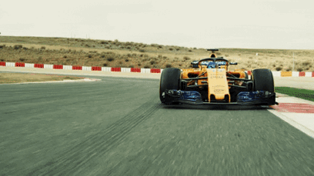

Why is DITA better?
Time & Money Savings
Open Standard
Flexibility & Reuse
Consistency
Productivity
Collaboration
Notes:
When you consider the benefits, DITA is the clear choice.

Slide 12

DITA FAQs
Question: What is DITA in technical writing?
Answer: DITA stands for The Darwin Information Typing Architecture. It's an XML data model for authoring, producing, and delivering technical information. This data model consists of a set of design principles that help to create and manage content separately from formatting.
Notes:
(Click) (DITA FAQs)
Let’s review DITA frequently asked questions.
(Read Q&A)

Slide 13

DITA FAQs (continued)
Question: What is a topic?
Answer: A topic is a chunk of information organized around a single subject. Structurally, it is a title followed by text and images, optionally organized into sections. Topics can be of many different types, the most common being concepts, tasks, and reference.
Notes:
(Click) (DITA FAQs continued)

Slide 14

DITA FAQs (continued)
Question: Is DITA good for conditional content?
Answer: Yes, DITA is good for conditional content. For example, you can automate the production of a Linux version of your documentation by only outputting topics and maps that set platform to “Linux” in the metadata.
Notes:
(Click) (DITA FAQs continued)

Slide 15

Conclusion
Why did I choose DITA?
Why is DITA better?
DITA FAQs
Notes:
(Click) I covered three things:
1. Why did I choose DITA?
2. Why is DITA better?
3. DITA FAQs
I’m proud that I learned DITA. My background, which includes chunking, tagging, and reusing content, helped prepare me to learn DITA.
I enjoyed using tools for this project, including DITA and Oxygen XML Author.
DITA is the best solution.
It enables content reuse and usability.
It is open, standard based. The DITA Open Toolkit is a free, open source solution that enables you to build a do-it-yourself solution.
It is consistent and predictable. It helps teams write with one voice.
It enhances collaboration, allowing authors to work together in parallel.
It enables minimalism. Because of the structure, it is easier to write concisely and omit needless words. This is good for technical writing.
Unlike Microsoft Word, DITA scales.
In conclusion, organizations looking to improve productivity, content accuracy, content repurposing, and reduce costs should consider DITA.
You don’t want to get left behind.

Slide 16

Thank you

